Slide 1
Module #3:
The Theory of Sets
26年 11月 8日
©2001-2004 Michael P. Frank, revised by S. Kang

Slide 2
Introduction to Set Theory (§1.6)
A set is a new type of structure, representing an unordered collection (group, plurality) of zero or more distinct (different) objects.
Set theory deals with operations between, relations among, and statements about sets.
Sets are ubiquitous in computer software systems.
All of mathematics can be defined in terms of some form of set theory (using predicate logic).
26年 11月 8日
©2001-2004 Michael P. Frank, revised by S. Kang

Slide 3
Basic notations for sets
For sets, we’ll use variables S, T, U, …
We can denote a set S in writing by listing all of its elements in curly braces:
  {a, b, c} is the set of whatever 3 objects are denoted by a, b, c.
Set builder notation: For any proposition P(x) over any universe of discourse, {x|P(x)} is the set of all x such that P(x).
26年 11月 8日
©2001-2004 Michael P. Frank, revised by S. Kang
Notes:
Discrete Mathematics and its Applications
26年 11月 8日
(c)2001-2002, Michael P. Frank

Slide 4
Basic properties of sets
Sets are inherently unordered:
  No matter what objects a, b, and c denote,
  {a, b, c} = {a, c, b} = {b, a, c} =
  {b, c, a} = {c, a, b} = {c, b, a}.
All elements are distinct (unequal);
multiple listings make no difference!
  If a=b, then {a, b, c} = {a, c} = {b, c} =
  {a, a, b, a, b, c, c, c, c}.
  This set contains (at most) 2 elements!
26年 11月 8日
©2001-2004 Michael P. Frank, revised by S. Kang

Slide 5
Ordered n-tuples
These are like sets, except that duplicates matter, and the order makes a difference.
For n∈N, an ordered n-tuple or a sequence or list of length n is written (a₁, a₂, …, a_{n}). Its first element is a₁, etc.
Note that (1, 2) ≠ (2, 1) ≠ (2, 1, 1).
Empty sequence, singlets, pairs, triples, quadruples, quintuples, …, n-tuples.
Contrast with
sets’ {}
26年 11月 8日
©2001-2004 Michael P. Frank, revised by S. Kang
Notes:
Discrete Mathematics and its Applications
26年 11月 8日
(c)2001-2002, Michael P. Frank

Slide 6
Definition of Set Equality
Two sets are declared to be equal if and only if they contain exactly the same elements.
In particular, it does not matter how the set is defined or denoted.
For example: The set {1, 2, 3, 4} =
{x | x is an integer where x>0 and x<5 } =
{x | x is a positive integer whose square
is >0 and <25}
26年 11月 8日
©2001-2004 Michael P. Frank, revised by S. Kang

Slide 7
Infinite Sets
Conceptually, sets may be infinite (i.e., not finite, without end, unending).
Symbols for some special infinite sets:
N = {0, 1, 2, …} The Natural numbers.
Z = {…, -2, -1, 0, 1, 2, …} The Zntegers.
R = The “Real” numbers, such as 374.1828471929498181917281943125…
“Blackboard Bold” or double-struck font (ℕ,ℤ,ℝ) is also often used for these special number sets.
Infinite sets come in different sizes!
More on this after module #4 (functions).
26年 11月 8日
©2001-2004 Michael P. Frank, revised by S. Kang

Slide 8
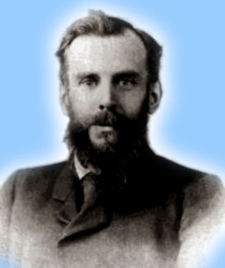
Venn Diagrams
John Venn
1834-1923
0
2
4
6
1
8
Even integers from 2 to 9
-1
3
5
7
9
Odd integers from 1 to 9
Positive integers less than 10
Primes <10
Integers from -1 to 9
26年 11月 8日
©2001-2004 Michael P. Frank, revised by S. Kang
Notes:
Discrete Mathematics and its Applications
26年 11月 8日
(c)2001-2002, Michael P. Frank

Slide 9
Basic Set Relations: Member of
x∈S (“x is in S”) is the proposition that object x is an ∈lement or member of set S.
  e.g. 3∈N, “a”∈{x | x is a letter of the alphabet}
  Can define set equality in terms of ∈ relation:
  ∀S,T: S=T ↔ (∀x: x∈S ↔ x∈T)
  “Two sets are equal iff they have all the same members.”
x∉S :≡ ¬(x∈S) “x is not in S”
26年 11月 8日
©2001-2004 Michael P. Frank, revised by S. Kang

Slide 10
The Empty Set
∅ (“null”, “the empty set”) is the unique set that contains no elements whatsoever.
∅ = {} = {x|False}
No matter the domain of discourse,
we have the axiom ¬∃x: x∈∅.
26年 11月 8日
©2001-2004 Michael P. Frank, revised by S. Kang

Slide 11
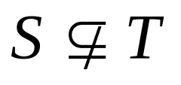
Subset and Superset Relations
S⊆T (“S is a subset of T”) means that every element of S is also an element of T.
S⊆T ⇔ ∀x (x∈S → x∈T)
∅⊆S, S⊆S.
S⊇T (“S is a superset of T”) means T⊆S.
Note S=T ⇔ S⊆T∧ S⊇T.
means ¬(S⊆T), i.e. ∃x(x∈S ∧ x∉T)
26年 11月 8日
©2001-2004 Michael P. Frank, revised by S. Kang
Notes:
Discrete Mathematics and its Applications
26年 11月 8日
(c)2001-2002, Michael P. Frank

Slide 12
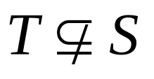
Proper (Strict) Subsets & Supersets
S⊂T (“S is a proper subset of T”) means that S⊆T but . Similar for S⊃T.
Example:
{1,2} ⊂
{1,2,3}
S
T
Venn Diagram equivalent of S⊂T
26年 11月 8日
©2001-2004 Michael P. Frank, revised by S. Kang
Notes:
Discrete Mathematics and its Applications
26年 11月 8日
(c)2001-2002, Michael P. Frank

Slide 13

Sets Are Objects, Too!
The objects that are elements of a set may themselves be sets.
E.g. let S={x | x ⊆ {1,2,3}}
then S={∅,
{1}, {2}, {3},
{1,2}, {1,3}, {2,3},
{1,2,3}}
Note that 1 ≠ {1} ≠ {{1}} !!!!
Very
Important!
26年 11月 8日
©2001-2004 Michael P. Frank, revised by S. Kang
Notes:
Discrete Mathematics and its Applications
26年 11月 8日
(c)2001-2002, Michael P. Frank

Slide 14
Cardinality and Finiteness
|S| (read “the cardinality of S”) is a measure of how many different elements S has.
E.g., |∅|=0, |{1,2,3}| = 3, |{a,b}| = 2,
|{{1,2,3},{4,5}}| = ____
If |S|∈N, then we say S is finite.
Otherwise, we say S is infinite.
What are some infinite sets we’ve seen?
2
N
Z
R
26年 11月 8日
©2001-2004 Michael P. Frank, revised by S. Kang

Slide 15
The Power Set Operation
The power set P(S) of a set S is the set of all subsets of S. P(S) :≡ {x | x⊆S}.
E.g. P({a,b}) = {∅, {a}, {b}, {a,b}}.
Sometimes P(S) is written 2^{S}.
Note that for finite S, |P(S)| = 2^{|S|}.
It turns out ∀S:|P(S)|>|S|, e.g. |P(N)| > |N|.
There are different sizes of infinite sets!
26年 11月 8日
©2001-2004 Michael P. Frank, revised by S. Kang
Notes:
Discrete Mathematics and its Applications
26年 11月 8日
(c)2001-2002, Michael P. Frank

Slide 16
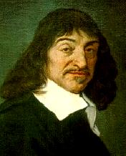
Cartesian Products of Sets
For sets A, B, their Cartesian product
A×B :≡ {(a, b) | a∈A ∧ b∈B }.
E.g. {a,b}×{1,2} = {(a,1),(a,2),(b,1),(b,2)}
Note that for finite A, B, |A×B|=|A||B|.
Note that the Cartesian product is not commutative: i.e., ¬∀AB: A×B=B×A.
Extends to A₁ × A₂ × … × A_{n}...
René Descartes
(1596-1650)
26年 11月 8日
©2001-2004 Michael P. Frank, revised by S. Kang
Notes:
Discrete Mathematics and its Applications
26年 11月 8日
(c)2001-2002, Michael P. Frank

Slide 17
The Union Operator
For sets A, B, their∪nion A∪B is the set containing all elements that are either in A, or (“∨”) in B (or, of course, in both).
Formally, ∀A,B: A∪B = {x | x∈A ∨ x∈B}.
Note that A∪B is a superset of both A and B (in fact, it is the smallest such superset):
∀A, B: (A∪B ⊇ A) ∧ (A∪B ⊇ B)
26年 11月 8日
©2001-2004 Michael P. Frank, revised by S. Kang

Slide 18

Union Examples
{a,b,c}∪{2,3} = {a,b,c,2,3}
{2,3,5}∪{3,5,7} = {2,3,5,3,5,7} ={2,3,5,7}
Required Form
2
5
3
7
26年 11月 8日
©2001-2004 Michael P. Frank, revised by S. Kang

Slide 19
The Intersection Operator
For sets A, B, their intersection A∩B is the set containing all elements that are simultaneously in A and (“∧”) in B.
Formally, ∀A,B: A∩B={x | x∈A ∧ x∈B}.
Note that A∩B is a subset of both A and B (in fact it is the largest such subset):
∀A, B: (A∩B ⊆ A) ∧ (A∩B ⊆ B)
26年 11月 8日
©2001-2004 Michael P. Frank, revised by S. Kang

Slide 20
Intersection Examples
{a,b,c}∩{2,3} = ___
{2,4,6}∩{3,4,5} = ______
∅
{4}
3
2
4
6
5
26年 11月 8日
©2001-2004 Michael P. Frank, revised by S. Kang

Slide 21
Disjointedness
Help, I’ve
been
disjointed!
Two sets A, B are called
disjoint (i.e., unjoined)
iff their intersection is
empty. (A∩B=∅)
Example: the set of even
integers is disjoint with
the set of odd integers.
26年 11月 8日
©2001-2004 Michael P. Frank, revised by S. Kang

Slide 22
Inclusion-Exclusion Principle
How many elements are in A∪B?
|A∪B| = |A| + |B| − |A∩B|
Example: How many students submitted their homework? Consider set E = I ∪ M,
I = {s | s turned in an paperback report}
M = {s | s sent the TAs their report file}
Some students did both!
|E| = |I∪M| = |I| + |M| − |I∩M|
26年 11月 8日
©2001-2004 Michael P. Frank, revised by S. Kang
Notes:
Discrete Mathematics and its Applications
26年 11月 8日
(c)2001-2002, Michael P. Frank

Slide 23
Set Difference
For sets A, B, the difference of A and B, written A−B, is the set of all elements that are in A but not B. Formally:
A − B :≡ {x | x∈A ∧ x∉B}
= {x | ¬(x∈A → x∈B) }
Also called:
The complement of B with respect to A.
26年 11月 8日
©2001-2004 Michael P. Frank, revised by S. Kang
Notes:
Discrete Mathematics and its Applications
26年 11月 8日
(c)2001-2002, Michael P. Frank

Slide 24
Set Difference Examples
{1,2,3,4,5,6} − {2,3,5,7,9,11} =
___________
Z − N = {… , −1, 0, 1, 2, … } − {0, 1, … }
= {x | x is an integer but not a nat. #}
= {x | x is a negative integer}
= {… , −3, −2, −1}
{1,4,6}
26年 11月 8日
©2001-2004 Michael P. Frank, revised by S. Kang

Slide 25
Set Difference - Venn Diagram
A−B is what’s left after B
“takes a bite out of A”
Chomp!
Set
A−B
Set A
Set B
26年 11月 8日
©2001-2004 Michael P. Frank, revised by S. Kang

Slide 26
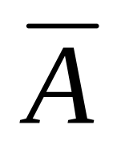
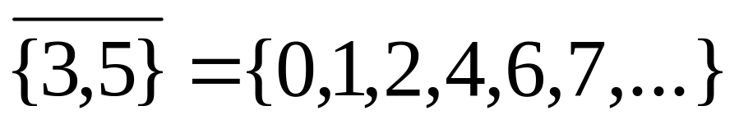
Set Complements
The universe of discourse can itself be considered a set, call it U.
When the context clearly defines U, we say that for any set A⊆U, the complement of A, written , is the complement of A w.r.t. U, i.e., it is U−A.
E.g., If U=N,
26年 11月 8日
©2001-2004 Michael P. Frank, revised by S. Kang

Slide 27
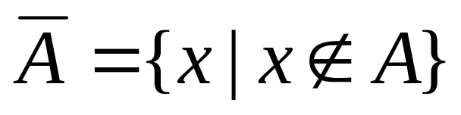
More on Set Complements
An equivalent definition, when U is clear:
A
U
26年 11月 8日
©2001-2004 Michael P. Frank, revised by S. Kang
Notes:
Discrete Mathematics and its Applications
26年 11月 8日
(c)2001-2002, Michael P. Frank

Slide 28
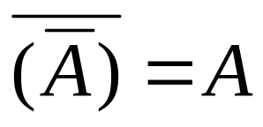
Set Identities
Identity: A∪∅ = A = A∩U
Domination: A∪U = U , A∩∅ = ∅
Idempotent: A∪A = A = A∩A
Double complement:
Commutative: A∪B = B∪A , A∩B = B∩A
Associative: A∪(B∪C)=(A∪B)∪C ,
A∩(B∩C)=(A∩B)∩C
26年 11月 8日
©2001-2004 Michael P. Frank, revised by S. Kang

Slide 29
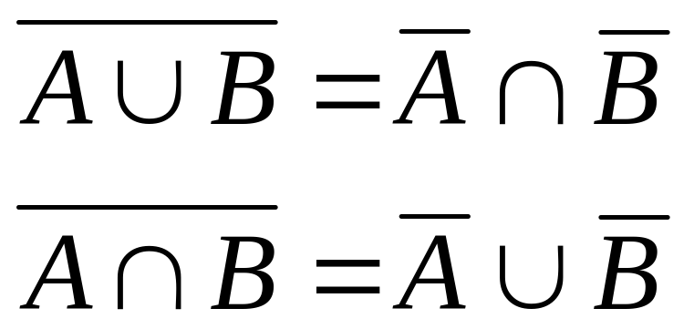
DeMorgan’s Law for Sets
Exactly analogous to (and provable from) DeMorgan’s Law for propositions.
26年 11月 8日
©2001-2004 Michael P. Frank, revised by S. Kang

Slide 30
Proving Set Identities
To prove statements about sets, of the form
E₁ = E₂ (where the Es are set expressions), here are three useful techniques:
1. Prove E₁ ⊆ E₂ and E₂ ⊆ E₁ separately.
2. Use set builder notation &
logical equivalences.
3. Use a membership table.
26年 11月 8日
©2001-2004 Michael P. Frank, revised by S. Kang
Notes:
Discrete Mathematics and its Applications
26年 11月 8日
(c)2001-2002, Michael P. Frank

Slide 31
Method 1: Mutual subsets
Example: Show A∩(B∪C)=(A∩B)∪(A∩C).
Part 1: Show A∩(B∪C)⊆(A∩B)∪(A∩C).
  Assume x∈A∩(B∪C), & show x∈(A∩B)∪(A∩C).
  We know that x∈A, and either x∈B or x∈C.
    Case 1: x∈B. Then x∈A∩B, so x∈(A∩B)∪(A∩C).
    Case 2: x∈C. Then x∈A∩C , so x∈(A∩B)∪(A∩C).
  Therefore, x∈(A∩B)∪(A∩C).
  Therefore, A∩(B∪C)⊆(A∩B)∪(A∩C).
Part 2: Show (A∩B)∪(A∩C) ⊆ A∩(B∪C). …
26年 11月 8日
©2001-2004 Michael P. Frank, revised by S. Kang

Slide 32
Method 3: Membership Tables
Just like truth tables for propositional logic.
Columns for different set expressions.
Rows for all combinations of memberships in constituent sets.
Use “1” to indicate membership in the derived set, “0” for non-membership.
Prove equivalence with identical columns.
26年 11月 8日
©2001-2004 Michael P. Frank, revised by S. Kang

Slide 33
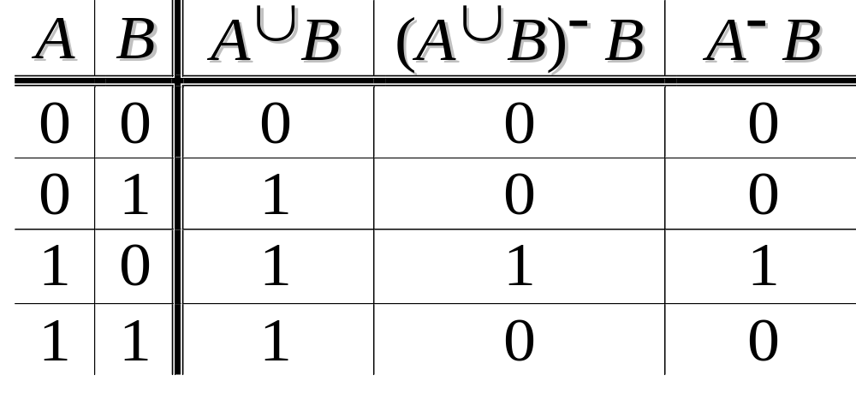
Membership Table Example
Prove (A∪B)−B = A−B.
26年 11月 8日
©2001-2004 Michael P. Frank, revised by S. Kang

Slide 34
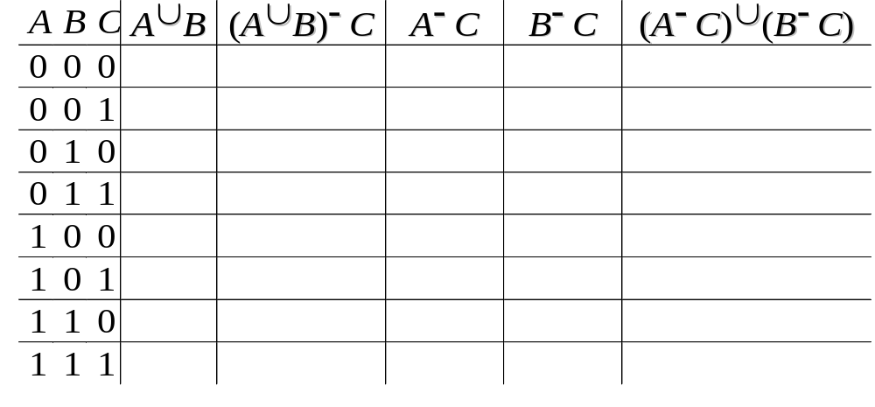
Membership Table Exercise
Prove (A∪B)−C = (A−C)∪(B−C).
26年 11月 8日
©2001-2004 Michael P. Frank, revised by S. Kang

Slide 35
Generalized Unions & Intersections
Since union & intersection are commutative and associative, we can extend them from operating on ordered pairs of sets (A,B) to operating on sequences of sets (A₁,…,A_{n}), or even on unordered sets of sets, X={A | P(A)}.
26年 11月 8日
©2001-2004 Michael P. Frank, revised by S. Kang

Slide 36

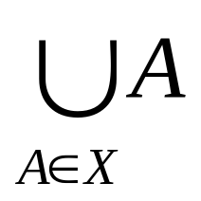
Generalized Union
Binary union operator: A∪B
n-ary union:
A₁∪A₂∪…∪A_{n} :≡ ((…((A₁∪ A₂) ∪…)∪ A_{n})
(grouping & order is irrelevant)
“Big U” notation:
Or for infinite sets of sets:
26年 11月 8日
©2001-2004 Michael P. Frank, revised by S. Kang

Slide 37
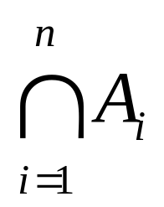
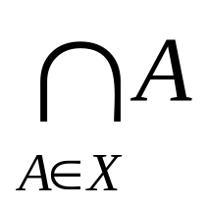
Generalized Intersection
Binary intersection operator: A∩B
n-ary intersection:
A₁∩A₂∩…∩A_{n}≡((…((A₁∩A₂)∩…)∩A_{n})
(grouping & order is irrelevant)
“Big Arch” notation:
Or for infinite sets of sets:
26年 11月 8日
©2001-2004 Michael P. Frank, revised by S. Kang

Slide 38
Representations
A frequent theme of this course will be methods of representing one discrete structure using another discrete structure of a different type.
E.g., one can represent natural numbers as
  Sets: 0:≡∅, 1:≡{0}, 2:≡{0,1}, 3:≡{0,1,2}, …
  Bit strings:
  0:≡0, 1:≡1, 2:≡10, 3:≡11, 4:≡100, …
26年 11月 8日
©2001-2004 Michael P. Frank, revised by S. Kang

Slide 39
Representing Sets with Bit Strings
For an enumerable u.d. U with ordering
x₁, x₂, …, represent a finite set S⊆U as the finite bit string B=b₁b₂…b_{n} where
∀i: x_{i}∈S ↔ (i<n ∧ b_{i}=1).
E.g. U=N, S={2,3,5,7,11}, B=001101010001.
In this representation, the set operators
“∪”, “∩”, “‾ ” are implemented directly by bitwise OR, AND, NOT!
26年 11月 8日
©2001-2004 Michael P. Frank, revised by S. Kang
Notes:
Discrete Mathematics and its Applications
26年 11月 8日
(c)2001-2002, Michael P. Frank

